Slide 1
object detection
Authentication of abondened
V.VAMSIKRISHNA
S.NAGENDRA BABU
SHAIK MANSOOR
@RGUKT RKV
Guide : M.DINESH REDDY

Slide 2
Image processing

Slide 3
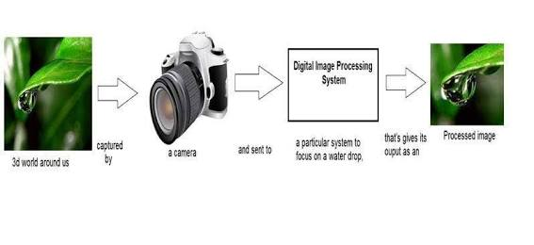
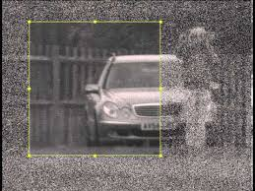
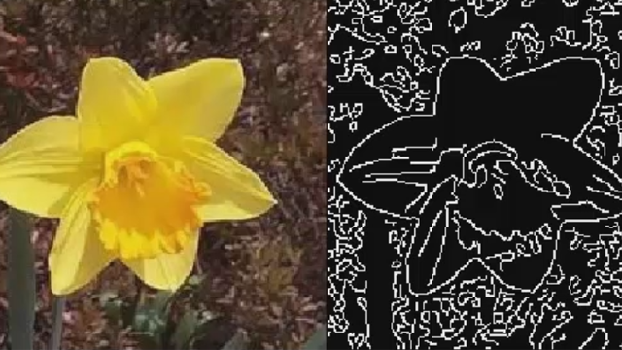
Image processing
Why
Image classification
Image editing
Image restoration
Image analysis
What
It is signal processing in which input is image and output image or characteristics
compression and image enhancement
Spotting patterns

Slide 4
Computer vision

Slide 5
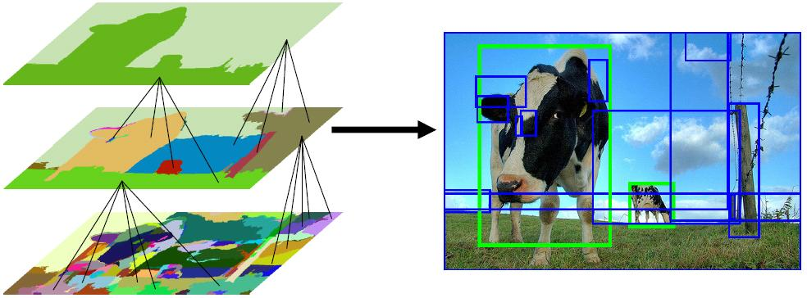
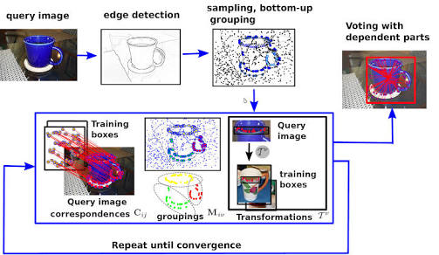
Computer vision
Detection
Pattern recognition
Classification
Recognition and track
How computers gain high level understanding of images and videos

Slide 6
Why OBJECT DETECTION
In an increasingly digital word, tracking the abondened objects and culprits is becoming more difficult.
Monitoring military,conflicts,illegal imigrants e.t.c

Slide 7
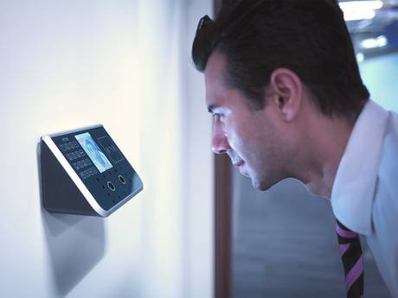
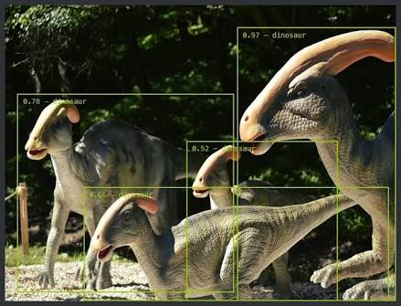
Why OBJECT DETECTION

Slide 8
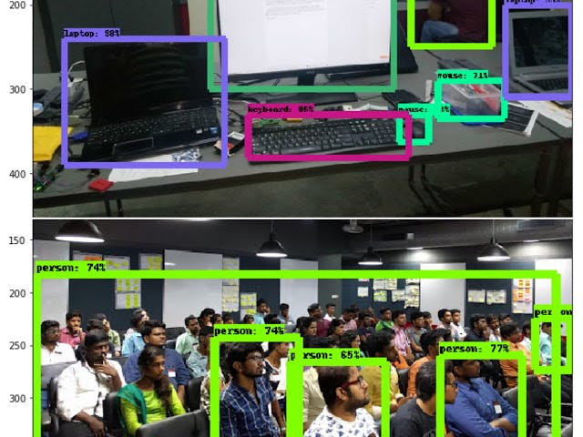
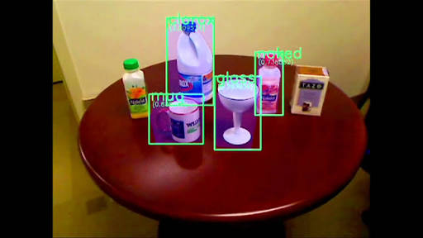
What is object detection???
detecting instances of semantic objects of a certain class in digital images and videos.

Slide 9

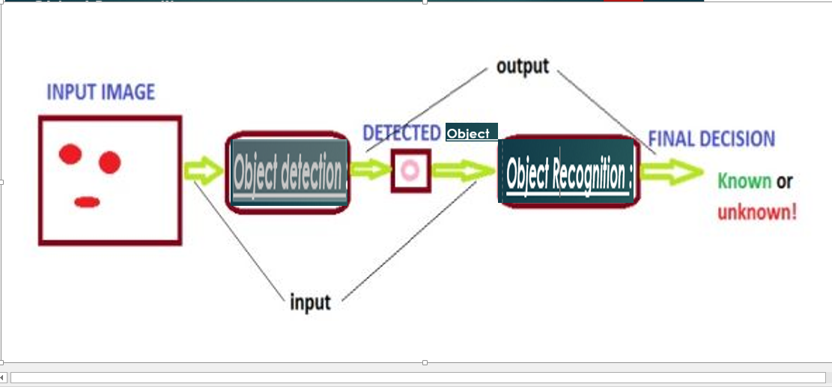
Confusion!!!
object detection & object recognition

Slide 10
Popular object detection Algorithms
Image segmentation
Image blob analysis
Shift operation
Hidden Markov model
Surf function

Slide 11

What ours method

Slide 12
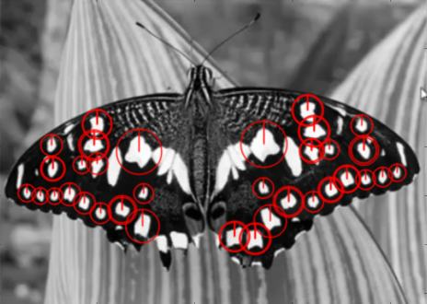
Surf feature detection , How does it works???
2048 -20048 feature points are there
Effective object detection must be able to handle cluttered scenes: changes to the object size, location, orientation
It can detect objects despite a scale change or in-plane
rotation. It is also robust to small amounts of out-of-plane rotation and occlusion.

Slide 13

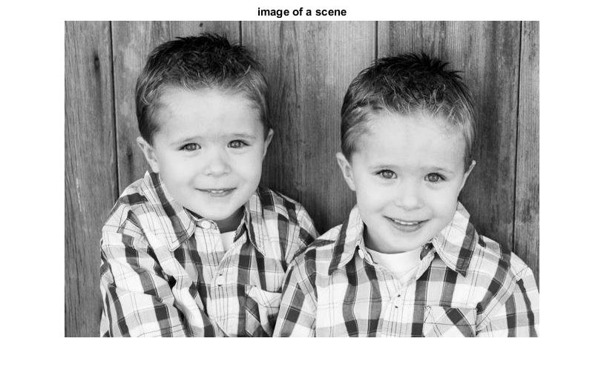
Reading image
Real image
Clustered image

Slide 14
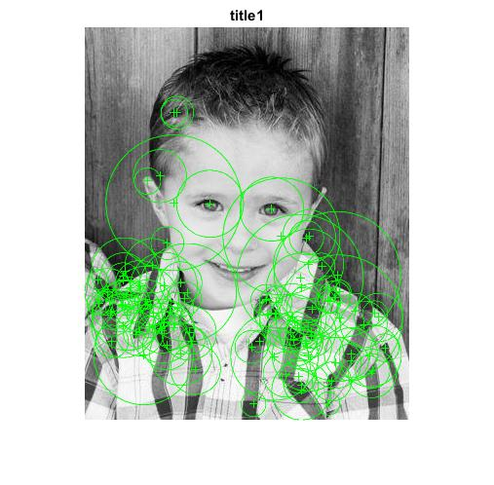
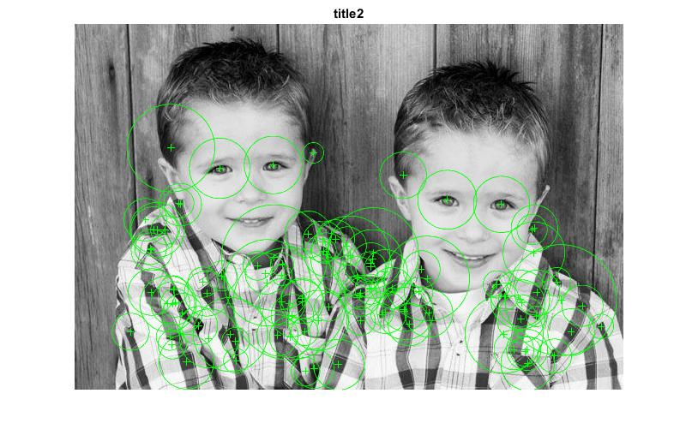
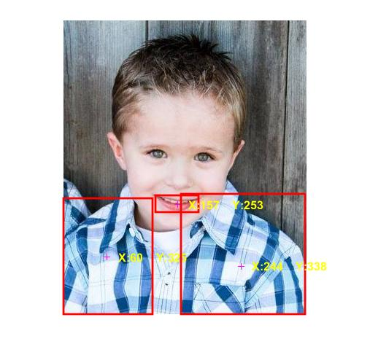
Feature points and descriptors
Real image
Clustered image

Slide 15
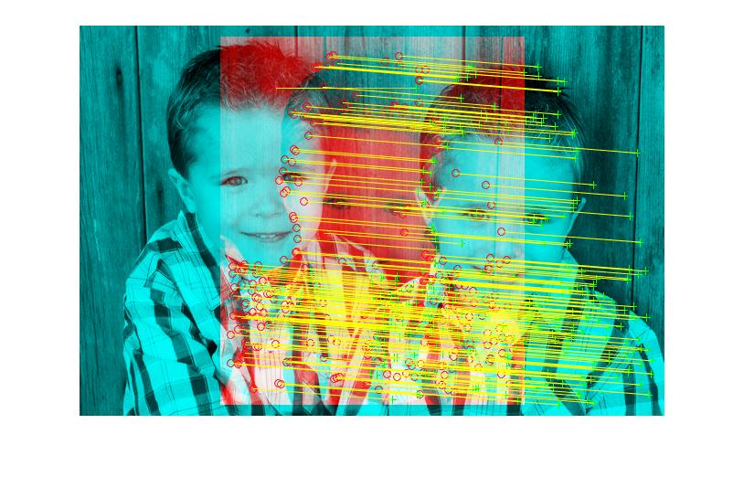
Point matches

Slide 16
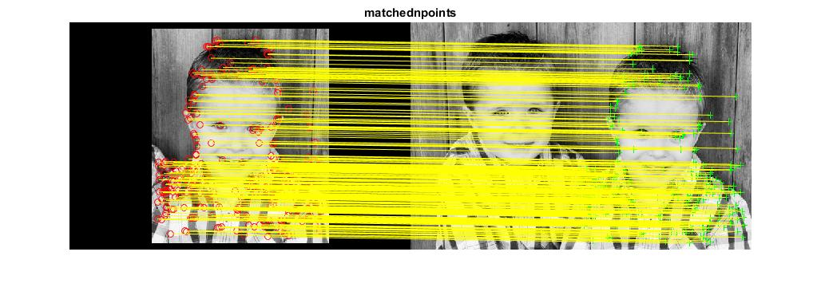
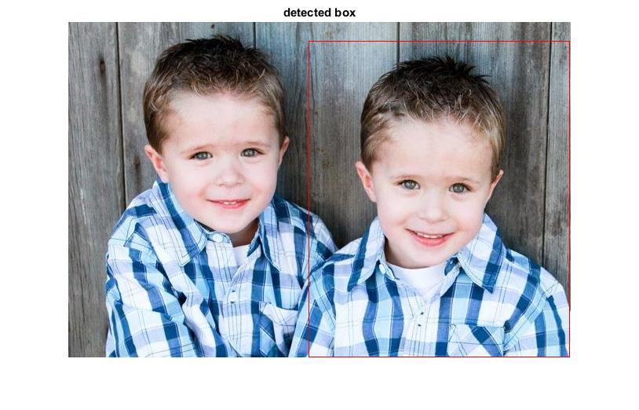
Locating the object in clustered scene

Slide 17
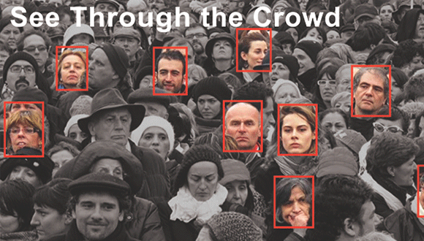
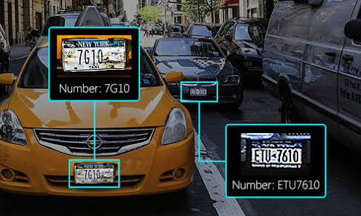
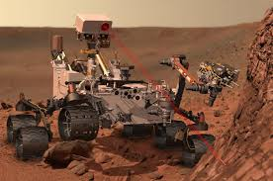
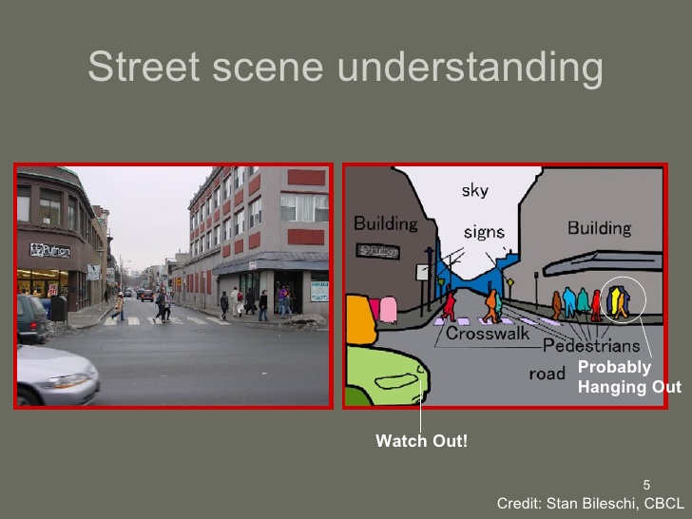
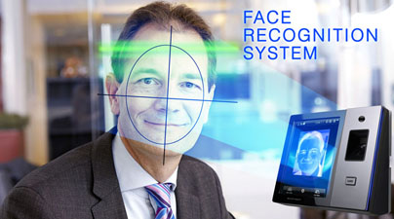
Applications and conclusion
Robotics
Crowd management
Traffic management
Video compression
Video surveillance
Vision based control
Medical imaging

Slide 18
Thank you

